Slide 1
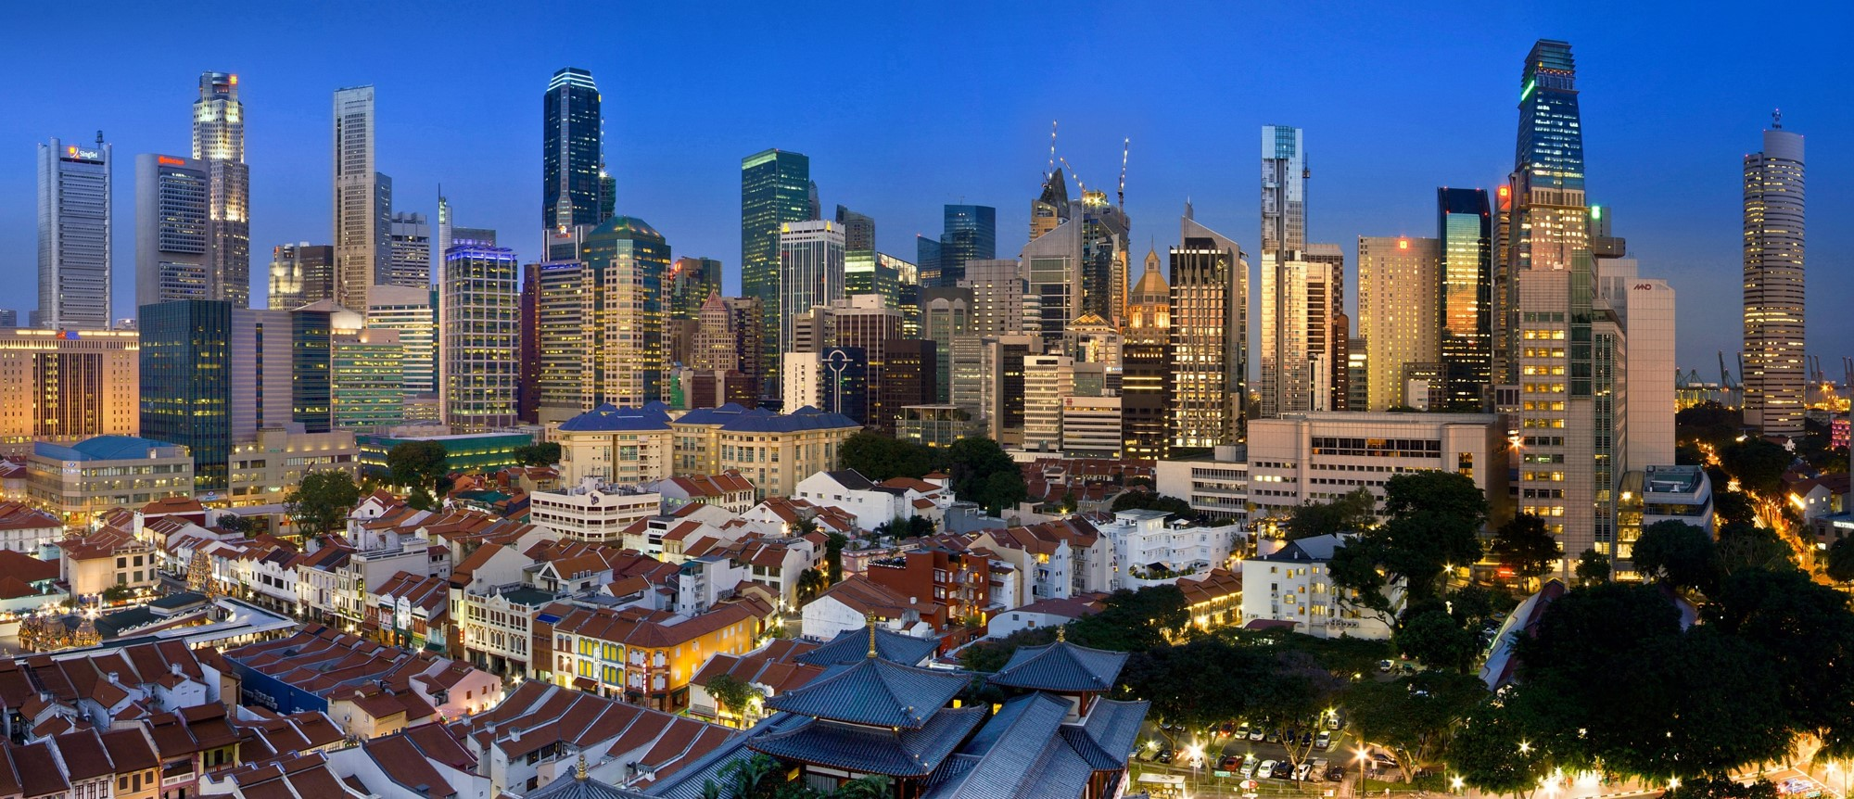
February 22-23, 2024 Melia Hanoi Hotel in Hanoi, Vietnam Read more at Trade Finance in the Mekong Region
Dissemination Event & Supply Chain Finance Workshop

Slide 2
Overview
PROGRAM – 22-Feb-2024
Melia Hanoi Hotel in Hanoi, Vietnam
Time | Session | Presenter/Moderator | Target Audience
8:30-9:30 | Registration of participants and networking
9:30-9:45 | Welcome remarks | Thomas Jacobs, IFC, Country Manager
9:45-10:00 | Words from organizers | Nathalie Louat, IFC, Director, Global Trade & Supply Chain Marc Auboin, WTO, Counsellor, Economic Research & Statistics | All participants
10:00-11:00 | Presentation of Trade Finance in the Mekong Region | Marc Auboin, WTO, Counsellor, Economic Research & Statistics Alexandros Ragoussis, IFC, Senior Economist Trang Thu Tran, IFC, Senior Economist Eddy Bekkers, WTO, Counsellor, Economic Research | Trade Finance Teams, Supply Chain Finance Teams, Corporate Teams, Trade Sales Unit/Front Office, Trade Operations, Relationship Managers
11:00-11:30 | Coffee Break
11:30-13:00 | Panel /Trade Finance Policy Discussion (public and private sector) | Moderator: Nathalie Louat, IFC, Director, Global Trade & Supply Chain Potential Panelists: Ms. Giang- General Director Department of Credit for Economic Sectors, State Bank of Vietnam Mr. Phu- Vietnam Trade Promotion Agency Director General, MOIT Mr. Hung- Secretary General, Vietnam Banking Association Mr. Lam- BIDV CEO, Largest trade finance market share bank Ms. Ha- SHB CEO, newly onboarded bank under our GTFP Marc Auboin, WTO, Counsellor, Economic Research & Statistics | Trade Finance Teams, Supply Chain Finance Teams, Corporate Teams, Trade Sales Unit/Front Office, Trade Operations, Relationship Managers
13:00-13:30 | Lunch
13:30-16:30 | Supply Chain Finance Training and Discussion -Deal Samples | Rajesh Mehra, IFC, Senior Operations Officer Shingo Kodama, IFC, Operations Officer Akintunde Ogunmodede, IFC, Regional Trade Lead – East Asia Pacific Susanne Kavelaar, IFC, Head, Trade Advisory Alexei Timofti, WTO, Trade Specialist | Trade Finance Teams, Supply Chain Finance Teams, Corporate Teams, Trade Sales Unit/Front Office, Trade Operations, Relationship Managers
16:30-17:00 | Wrap Up, Survey & Group Photo | Marc Auboin, WTO, Counsellor, Economic Research & Statistics Leopoldo Sposato, IFC, Manager, Global Trade & Supply Chain

