Slide 1
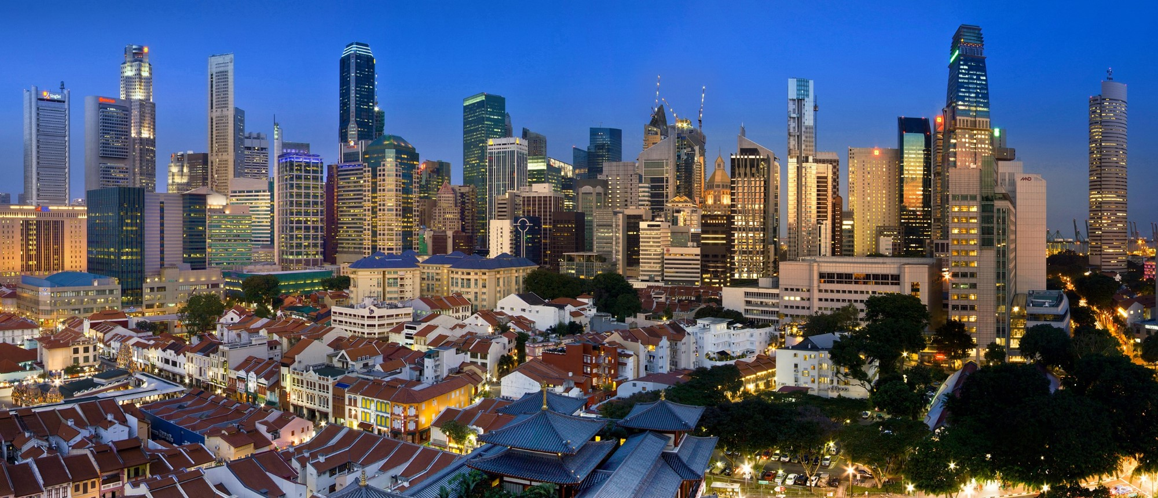
February 19, 2024 Hyatt Regency Hotel in Phnom Penh, Cambodia Read more at Trade Finance in the Mekong Region
Dissemination Event & Trade Operations Workshop

Slide 2
Overview
PROGRAM – 18-Feb-2024
Hyatt Regency Hotel in Phnom Penh, Cambodia
Time | Session
All day | Arrival and Check-in
18:00 – 19:00 | Team Meeting | Nathalie Louat, IFC, Director, Global Trade & Supply Chain Susanne Kavelaar, IFC, Head, Trade Advisory Marc Auboin, WTO, Counsellor, Economic Research & Statistics Akintunde Ogunmodede, IFC, Regional Trade Lead – Asia Pacific Nhung Cam Nguyen, IFC, Associate Trade Finance Officer Alexei Timofti, WTO, Trade Specialist Alexandros Ragoussis, IFC, Senior Economist Trang Thu Tran, IFC, Senior Economist Eddy Bekkers, WTO, Economic Research & Statistics | to discuss/review events of the following day and week

Slide 3
Overview
PROGRAM – 19-Feb-2024
Hyatt Regency Hotel in Phnom Penh, Cambodia
Time | Session | Presenter/Moderator | Target Audience
8:30-9:30 | Registration of participants and networking
9:30-9:45 | Opening Session - Words from organizers | Nathalie Louat, IFC, Director, Global Trade & Supply Chain Marc Auboin, WTO, Counsellor, Economic Research & Statistics | All participants
9:45-10:30 | Presentation of Trade Finance in the Mekong Region | Marc Auboin, WTO, Counsellor, Economic Research & Statistics Alexandros Ragoussis, IFC, Senior Economist Eddy Bekkers, WTO, Counsellor, Economic Research Trang Thu Tran, IFC, Senior Economist | Trade Finance Teams, Supply Chain Finance Teams, Corporate Teams, Trade Sales Unit/Front Office, Trade Operations, Relationship Managers
10:30 - 11:00 | Coffee Break
11:00-12:30 | Training and Panel discussion (public and private sector) | Marc Auboin, WTO, Counsellor, Economic Research & Statistics Acleda Bank - Dr. In Channy - Group Managing Director ABA Bank Cambodia - Askhat Azhikhanov- CEO The Association of Banks in Cambodia – Abby Phal-Chalm, Secretary General Ministry of Trade- Mr Kemvichet Long, Director-General of Trade Nathalie Louat, IFC, Director, Global Trade & Supply Chain | Trade Finance Teams, Supply Chain Finance Teams, Corporate Teams, Trade Sales Unit/Front Office, Trade Operations, Relationship Managers
12:30-13:00 | Q&A Session
13:00-14:00 | Lunch
14:00-16:15 | Training | Margaret Makura, Cedar Point Global, Consultant Susanne Kavelaar, IFC, Head, Trade Advisory Marc Auboin, WTO, Counsellor Alexei Timofti, WTO, Trade Specialist | Trade Finance Teams, Supply Chain Finance Teams, Corporate Teams, Trade Sales Unit/Front Office, Trade Operations, Relationship Managers
16:15-16:45 | Wrap Up, Survey & Group Photo | Asad Yaqub, IFC, Resident Representative

Slide 4
Overview
PANEL QUESTIONS – 19-Feb-2024
Hyatt Regency Hotel in Phnom Penh, Cambodia
QUESTIONS FOR CAMBODIA
Access to trade finance is extremely low in Cambodia, well below other developing countries studied to data. An increase in the share of trade and reduction of its costs would improve trade flows and inclusiveness. What should be done to improve trade finance mobilization in Cambodia?
Cambodia’s local trade finance market seems rather traditional, segmented, expensive. Local firms seem to be at a disadvantage in value chains against first-tier, foreign owned firms. They seem to rely a lot more on expensive traditional financing, in lieu of trade finance, such as working capital: what are the underlying problems, and how can they be addressed?
Large firms benefit from greater access to bank-intermediated trade finance according to our survey: do you think this is more a reflection of underlying problems in the bank side or structural problems of smaller producers?
Trade Finance – and SCF in particular - can optimize firms financial management and free resources for investment and innovation, ultimately improving productivity and diversification. What actions do you see as more promising to promote the role of trade finance, particularly SCF ?
Despite data collection and analytical studies – including this publication – examining trade finance, evidence on gaps and potential remains scarce. What kind of questions and evidence would help you most to improve your understanding of the market, and address its failures?
Chamber of Commerce Cambodia
Many local firms surveyed seem to trade without bank-intermediation, by using expensive and risky alternatives. Do you think this is more a reflection of underlying problems in the bank side or structural problems of producers?
The majority of surveyed banks in the Mekong-3 do not track whether or not they provide trade finance to firms owned or led by women, which makes it a challenge to discuss the gender gap. In your experience is there indeed a gap in access, and what would be the biggest constraint to improve women-led firms use of trade finance?
Ministry of Industry and Trade Cambodia
What are the competitive strengths of trade activities in Cambodia in terms of various stages in the value chains? Do you think that access to affordable finance, notably trade finance plays a role?
In countries such as Philippines and Pakistan, the role of the regulator was crucial for certain trade finance reforms. Do you see a reform agenda to support growth of trade finance in your country ?
A number of issues have been raised in the report preventing firms from accessing trade finance: lack of financials, lack of recognizable invoice, lack of collateral etc. Are there any policy measures on firms' side which could have support trade finance market development in Cambodia?

Slide 5
Overview
PROGRAM – 19-Feb-2024
Hyatt Regency Hotel in Phnom Penh, Cambodia
State/Central Bank of Cambodia
SCF accounts for only 2.4 % of local trade finance, while SC trade accounts for around 47% of trade flows. In your view, what can be done to support the development of SCF in the country ?
Are there practical steps which could improve access of local SMEs to trade-related lending markets (pre-shipment finance, import finance)
Has the State/Central Bank of Cambodia been looking at other experiences of development of receivable markets (India or Mexican system of auctioning of trade bills)
Cambodia Banking Association
How has the importance of different market segments, the composition of market participants, and the availability of trade finance changed over time, also taking into consideration the impact of Covid-19 related disruptions such as inflation, limited availability of low-cost funding, and structural constraints etc.
Multinational producers and high-tech manufacturing are shown to rely less on local banks for trade finance – is this a segment you target or see potential in engaging with? [same question to banks potentially]
Private Banks (ACLEDA?XXX)
Innovative trade finance instruments are still nascent, supply chain finance accounts for only 2% of trade finance supplied locally, despite the large growth potential. What are some of the challenges and opportunities banks see in such innovative areas? Why do you think it is taking off slowly? For low-hanging opportunities, which sectors/segments do banks tend to view as good fit?
In Cambodia, only 11 per cent of the banks report that they provide trade finance to climate-related activities . Why is this the case, and what would it take to harness the potential of trade finance in supporting climate-friendly trade

